Slide 1
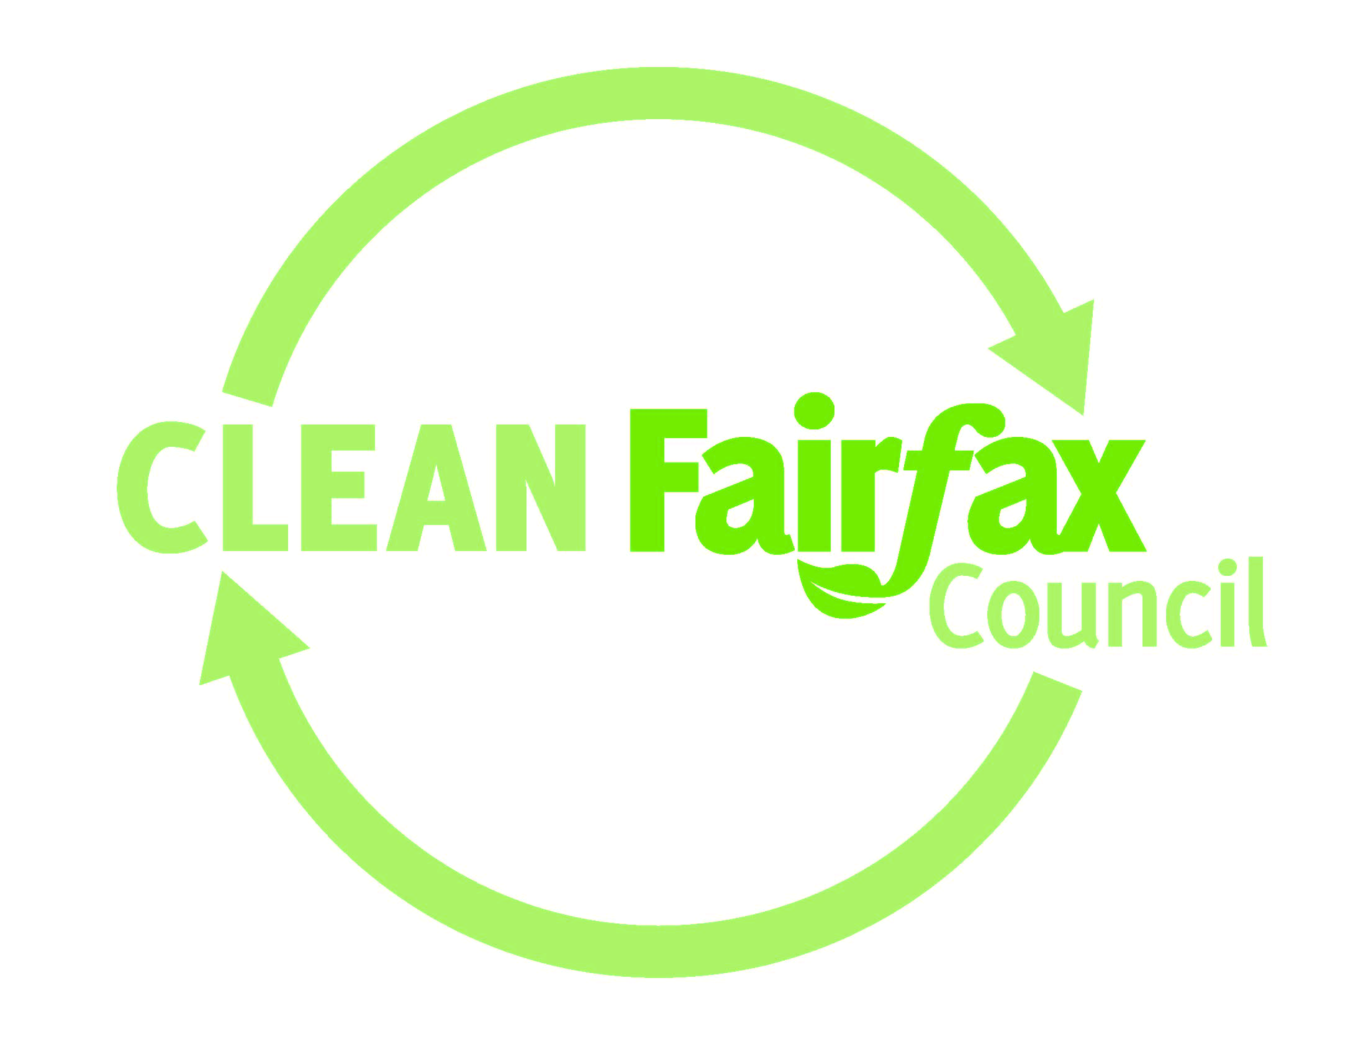
Clean Fairfax: The State of Litter in Fairfax County September 2022 Report plus “Bag Fee” Preliminary Data

Slide 2
About Clean Fairfax
Established in 1979 as a Board of Supervisors Task Force on Litter
Incorporated as a 501c3 non profit in 1985
Private Public Partnership with Department of Public Works and Environmental Services
Solid Waste Management
Stormwater MS4 Permit Compliance
Litter Task Force

Slide 3
The Litter Task Force
Clean Fairfax, with DPWES/Solid Waste as co-leaders, worked with County Agencies and other environmental nonprofits from October 2019 to December 2020 at the request of the Fairfax County Board of Supervisors.
This presentation includes the recommendations that group presented to the Environmental Committee of the Board of Supervisors

Slide 4
The Problem
Overuse of Single Use Plastics
Trash escapes containers and becomes litter
Inadequate systems for residential and commercial needs
Enforcement

Slide 5
Task Force Scope of Work – Jan-Dec 2021
Gather
Existing Data
County, government and NGO sources, other localities
Geospatial and field assessment of Fairfax streams
Identify
Key Sources
Single-use plastics (lightweight/
Solid waste management infrastructure inadequacies
Create
Solutions for Proactive Change
Survey
Stakeholders and Report Responses
Present
Final Report
fly-away)
Clean Fairfax co-lead the Litter Task Force for Fairfax County

Slide 7
Let’s Trace The Trash

Slide 8
Short-Term Recommendations
End
Discontinue single-use plastics for county events
Include a ban on single-use water bottles
Ensure
Ensure adequate recycling and trash systems in place at all county facilities
Install
Install water bottle filling stations in government buildings
Review
Review development plans for waste system adequacy
Support
Coordinate/ Support Cover Your Load week
Sponsor
Sponsor regular free disposal days (“Dumpster Days”)

Slide 9
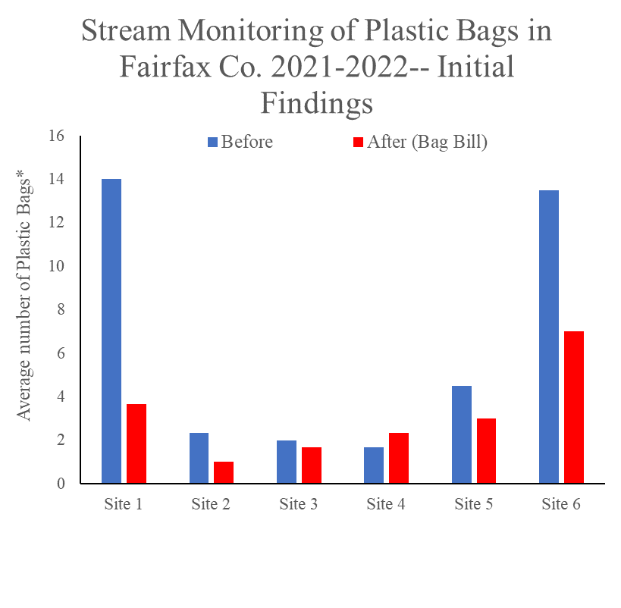
Completed Short-Term Recommendations
Disposable Plastic Bag Tax Ordinance implemented January 1, 2022
Preliminary data from stream monitoring shows reduction in plastic bag pollution
The two most polluted streams had 47% and 74% less plastic bags after January 2021

Slide 10
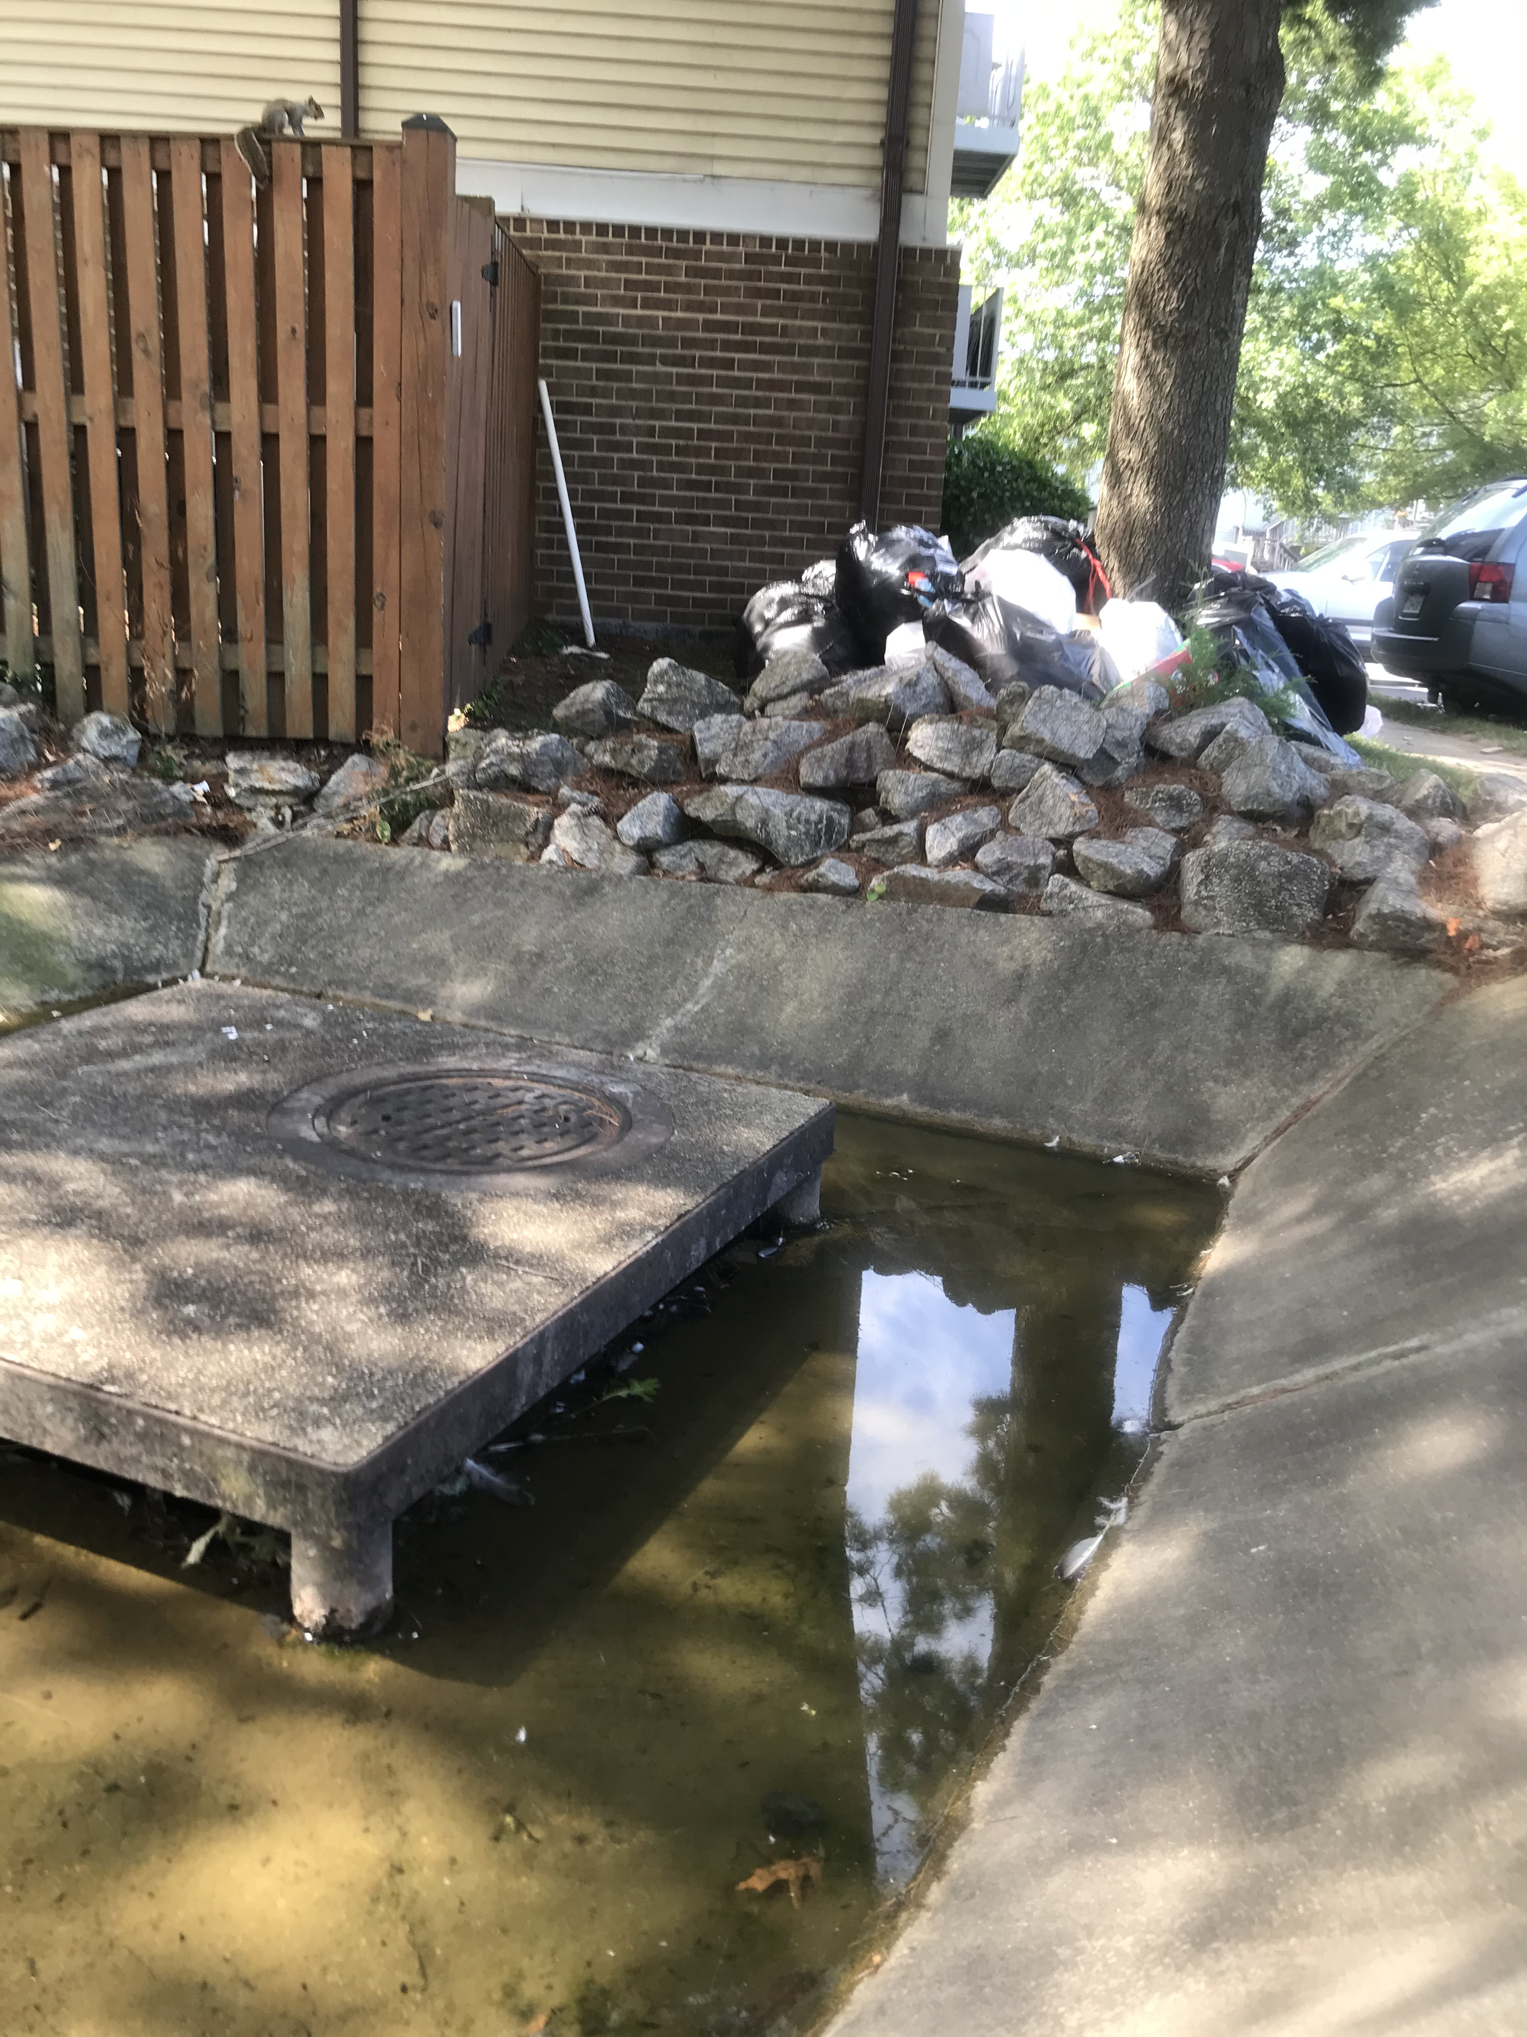
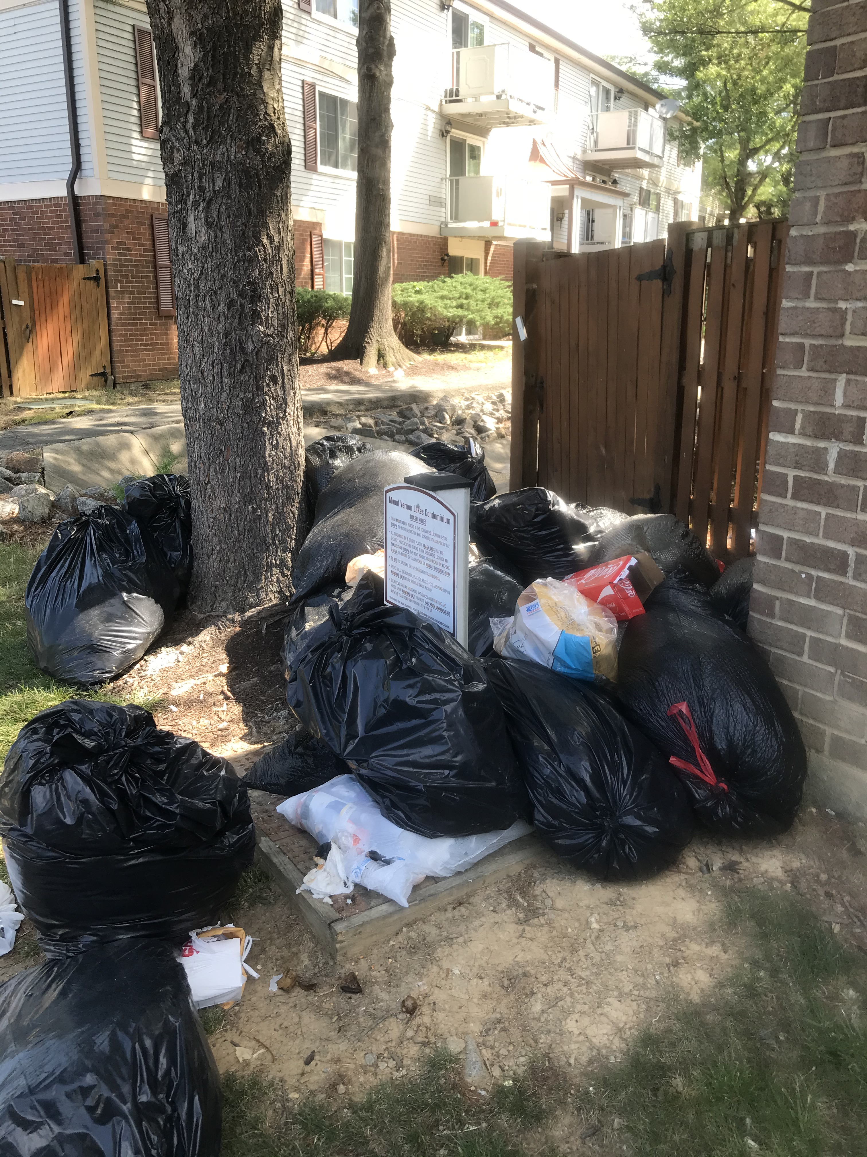
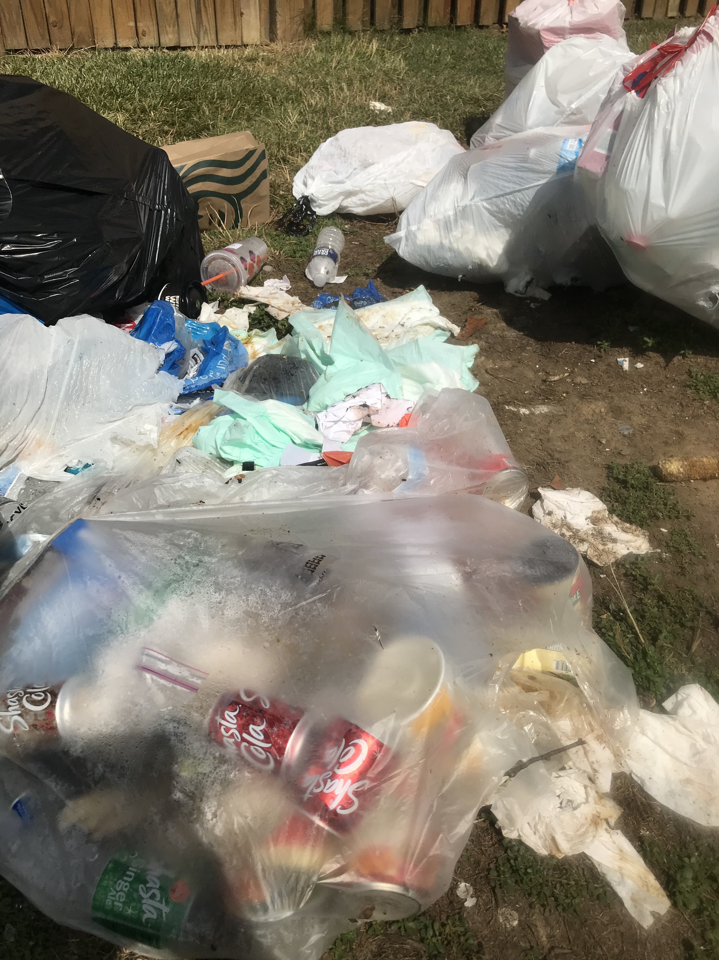
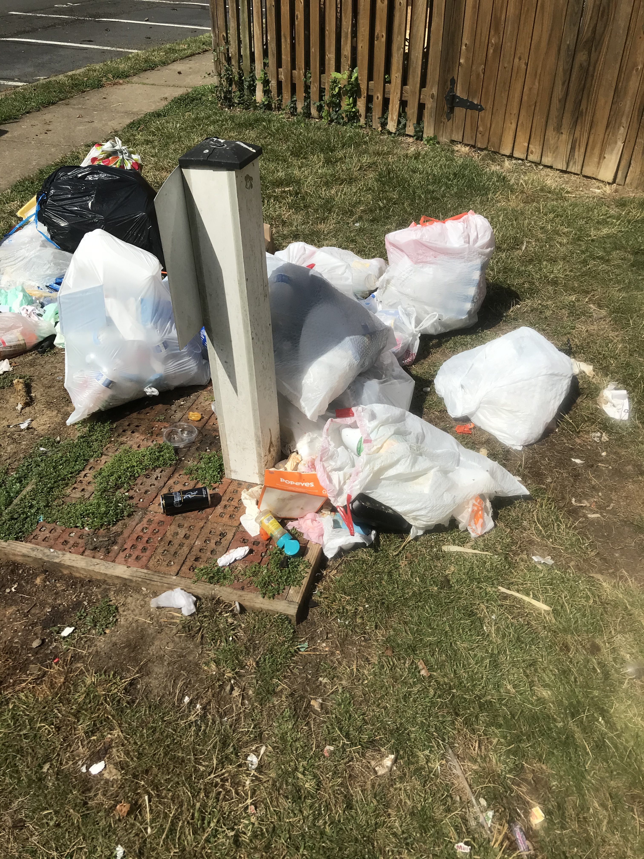
These are some problems in the neighborhoods –lack of containers; too close to storm drains

Slide 11
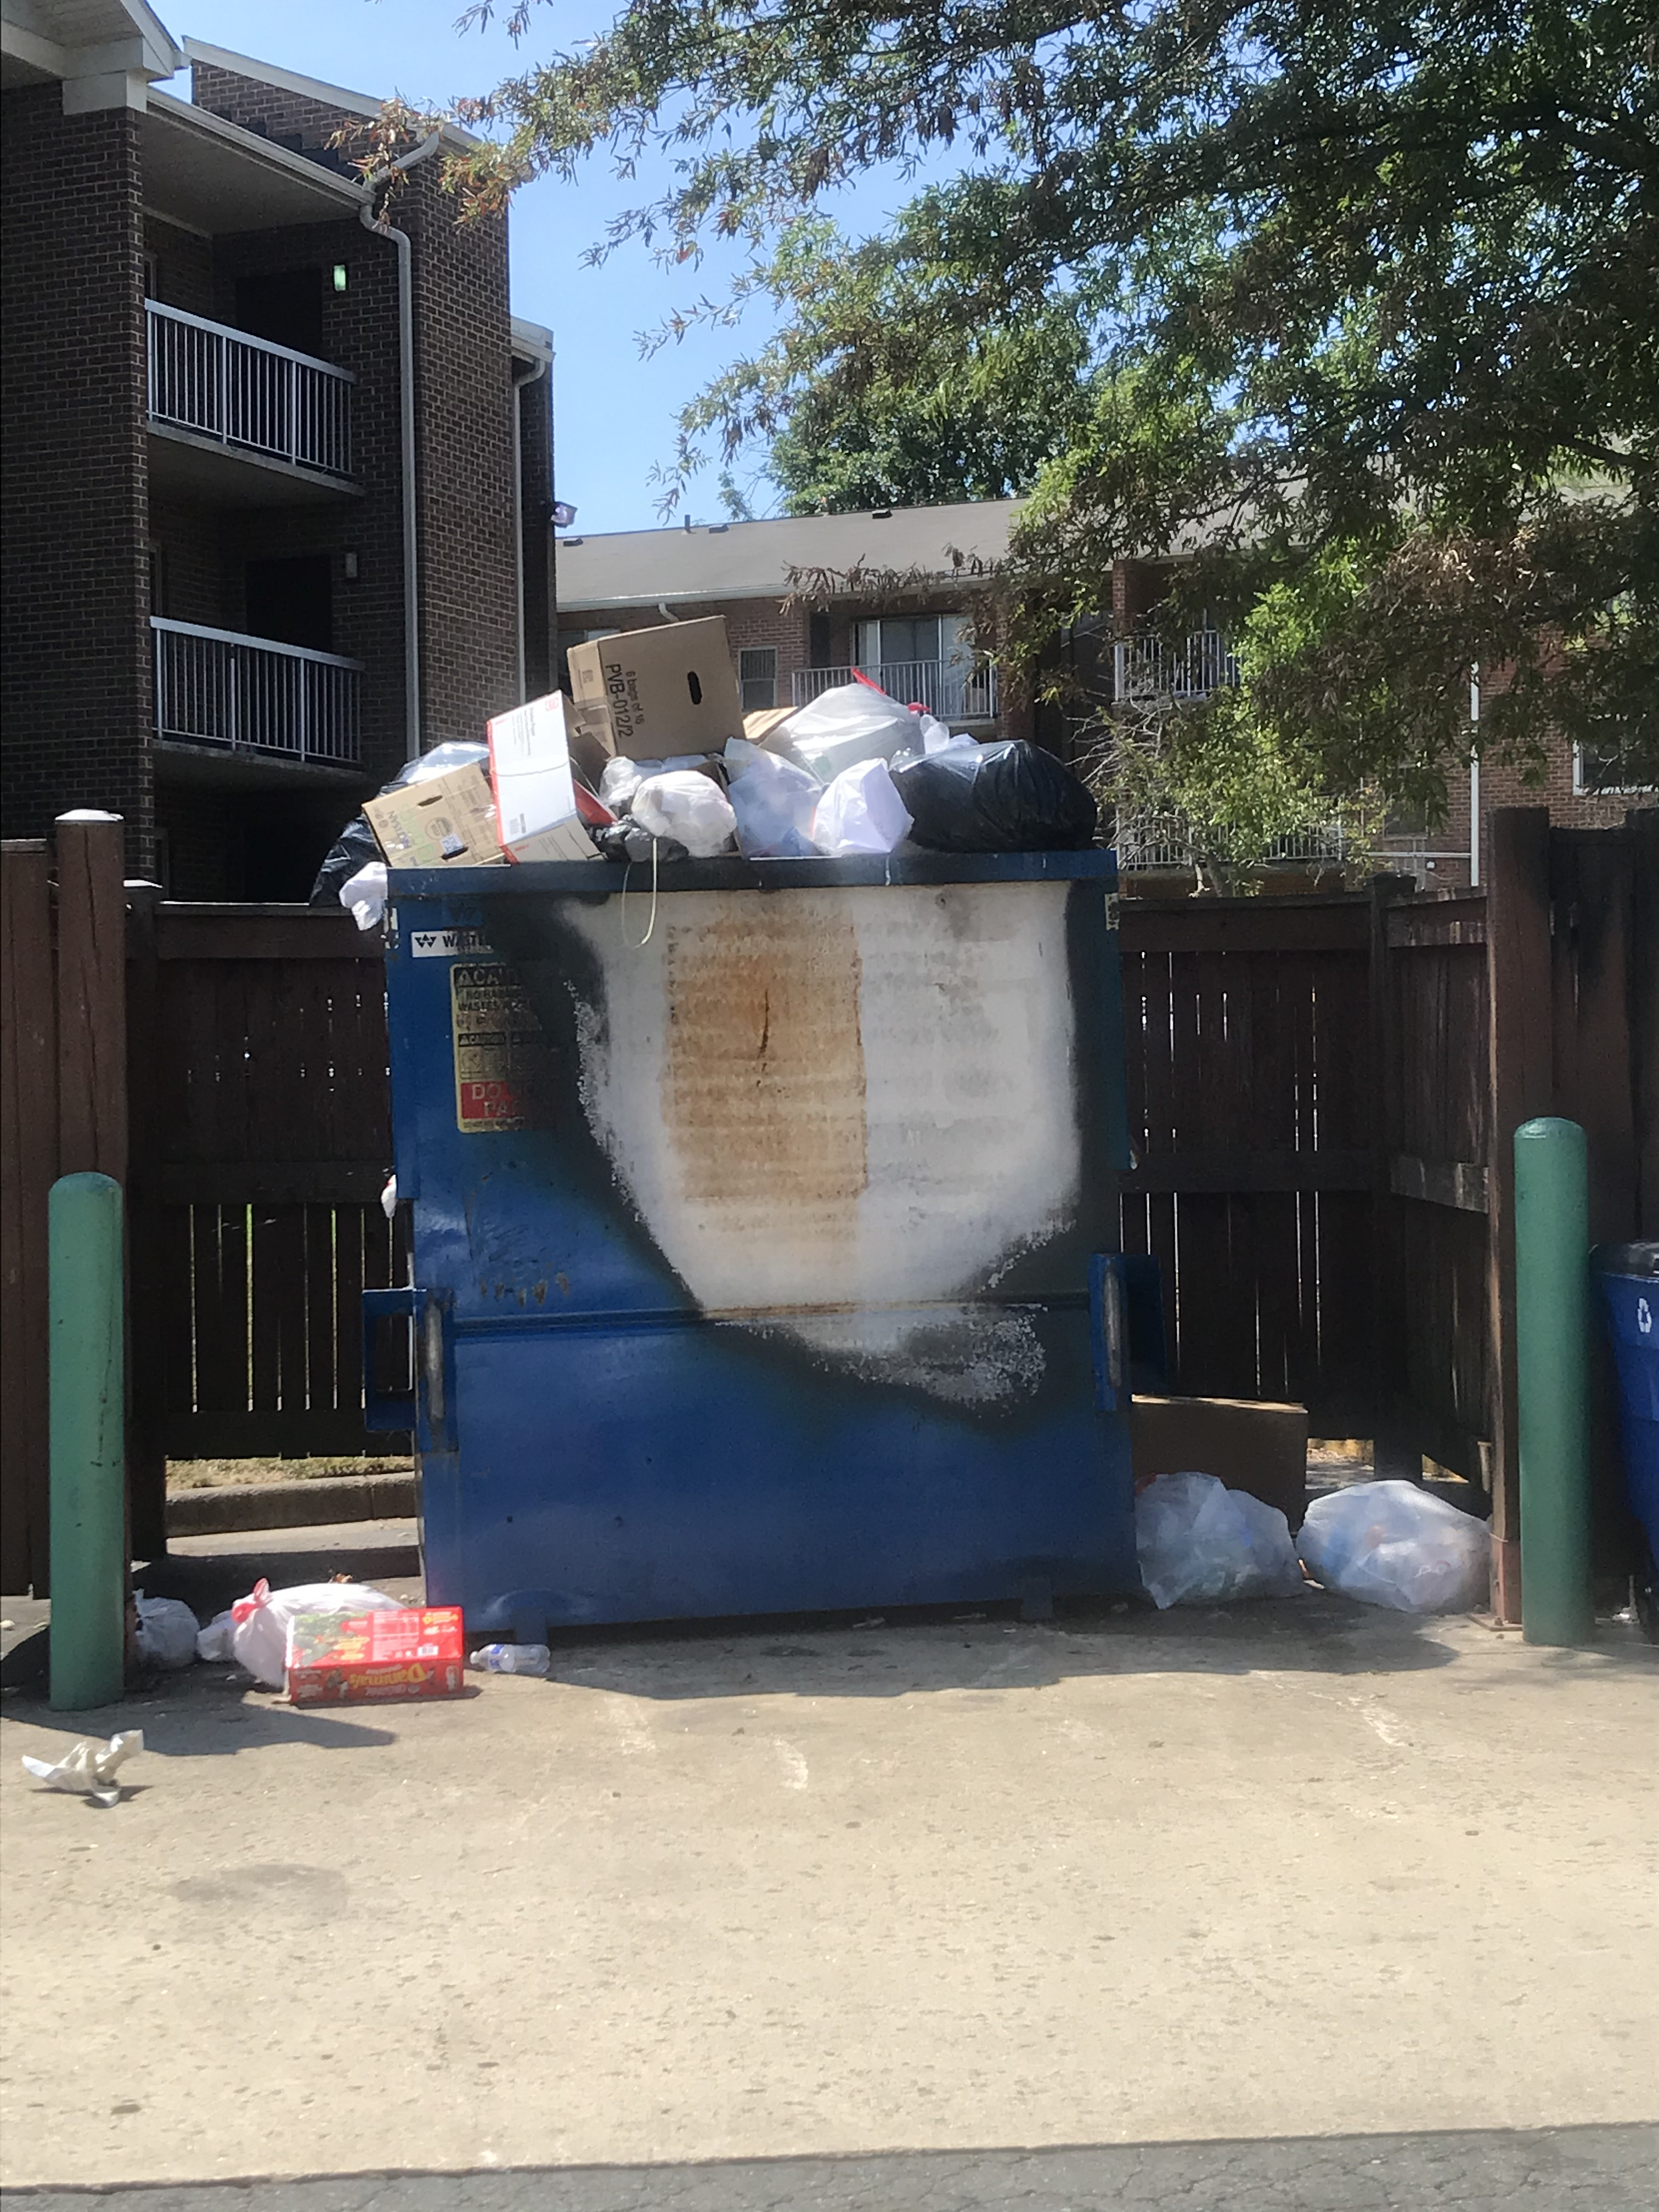
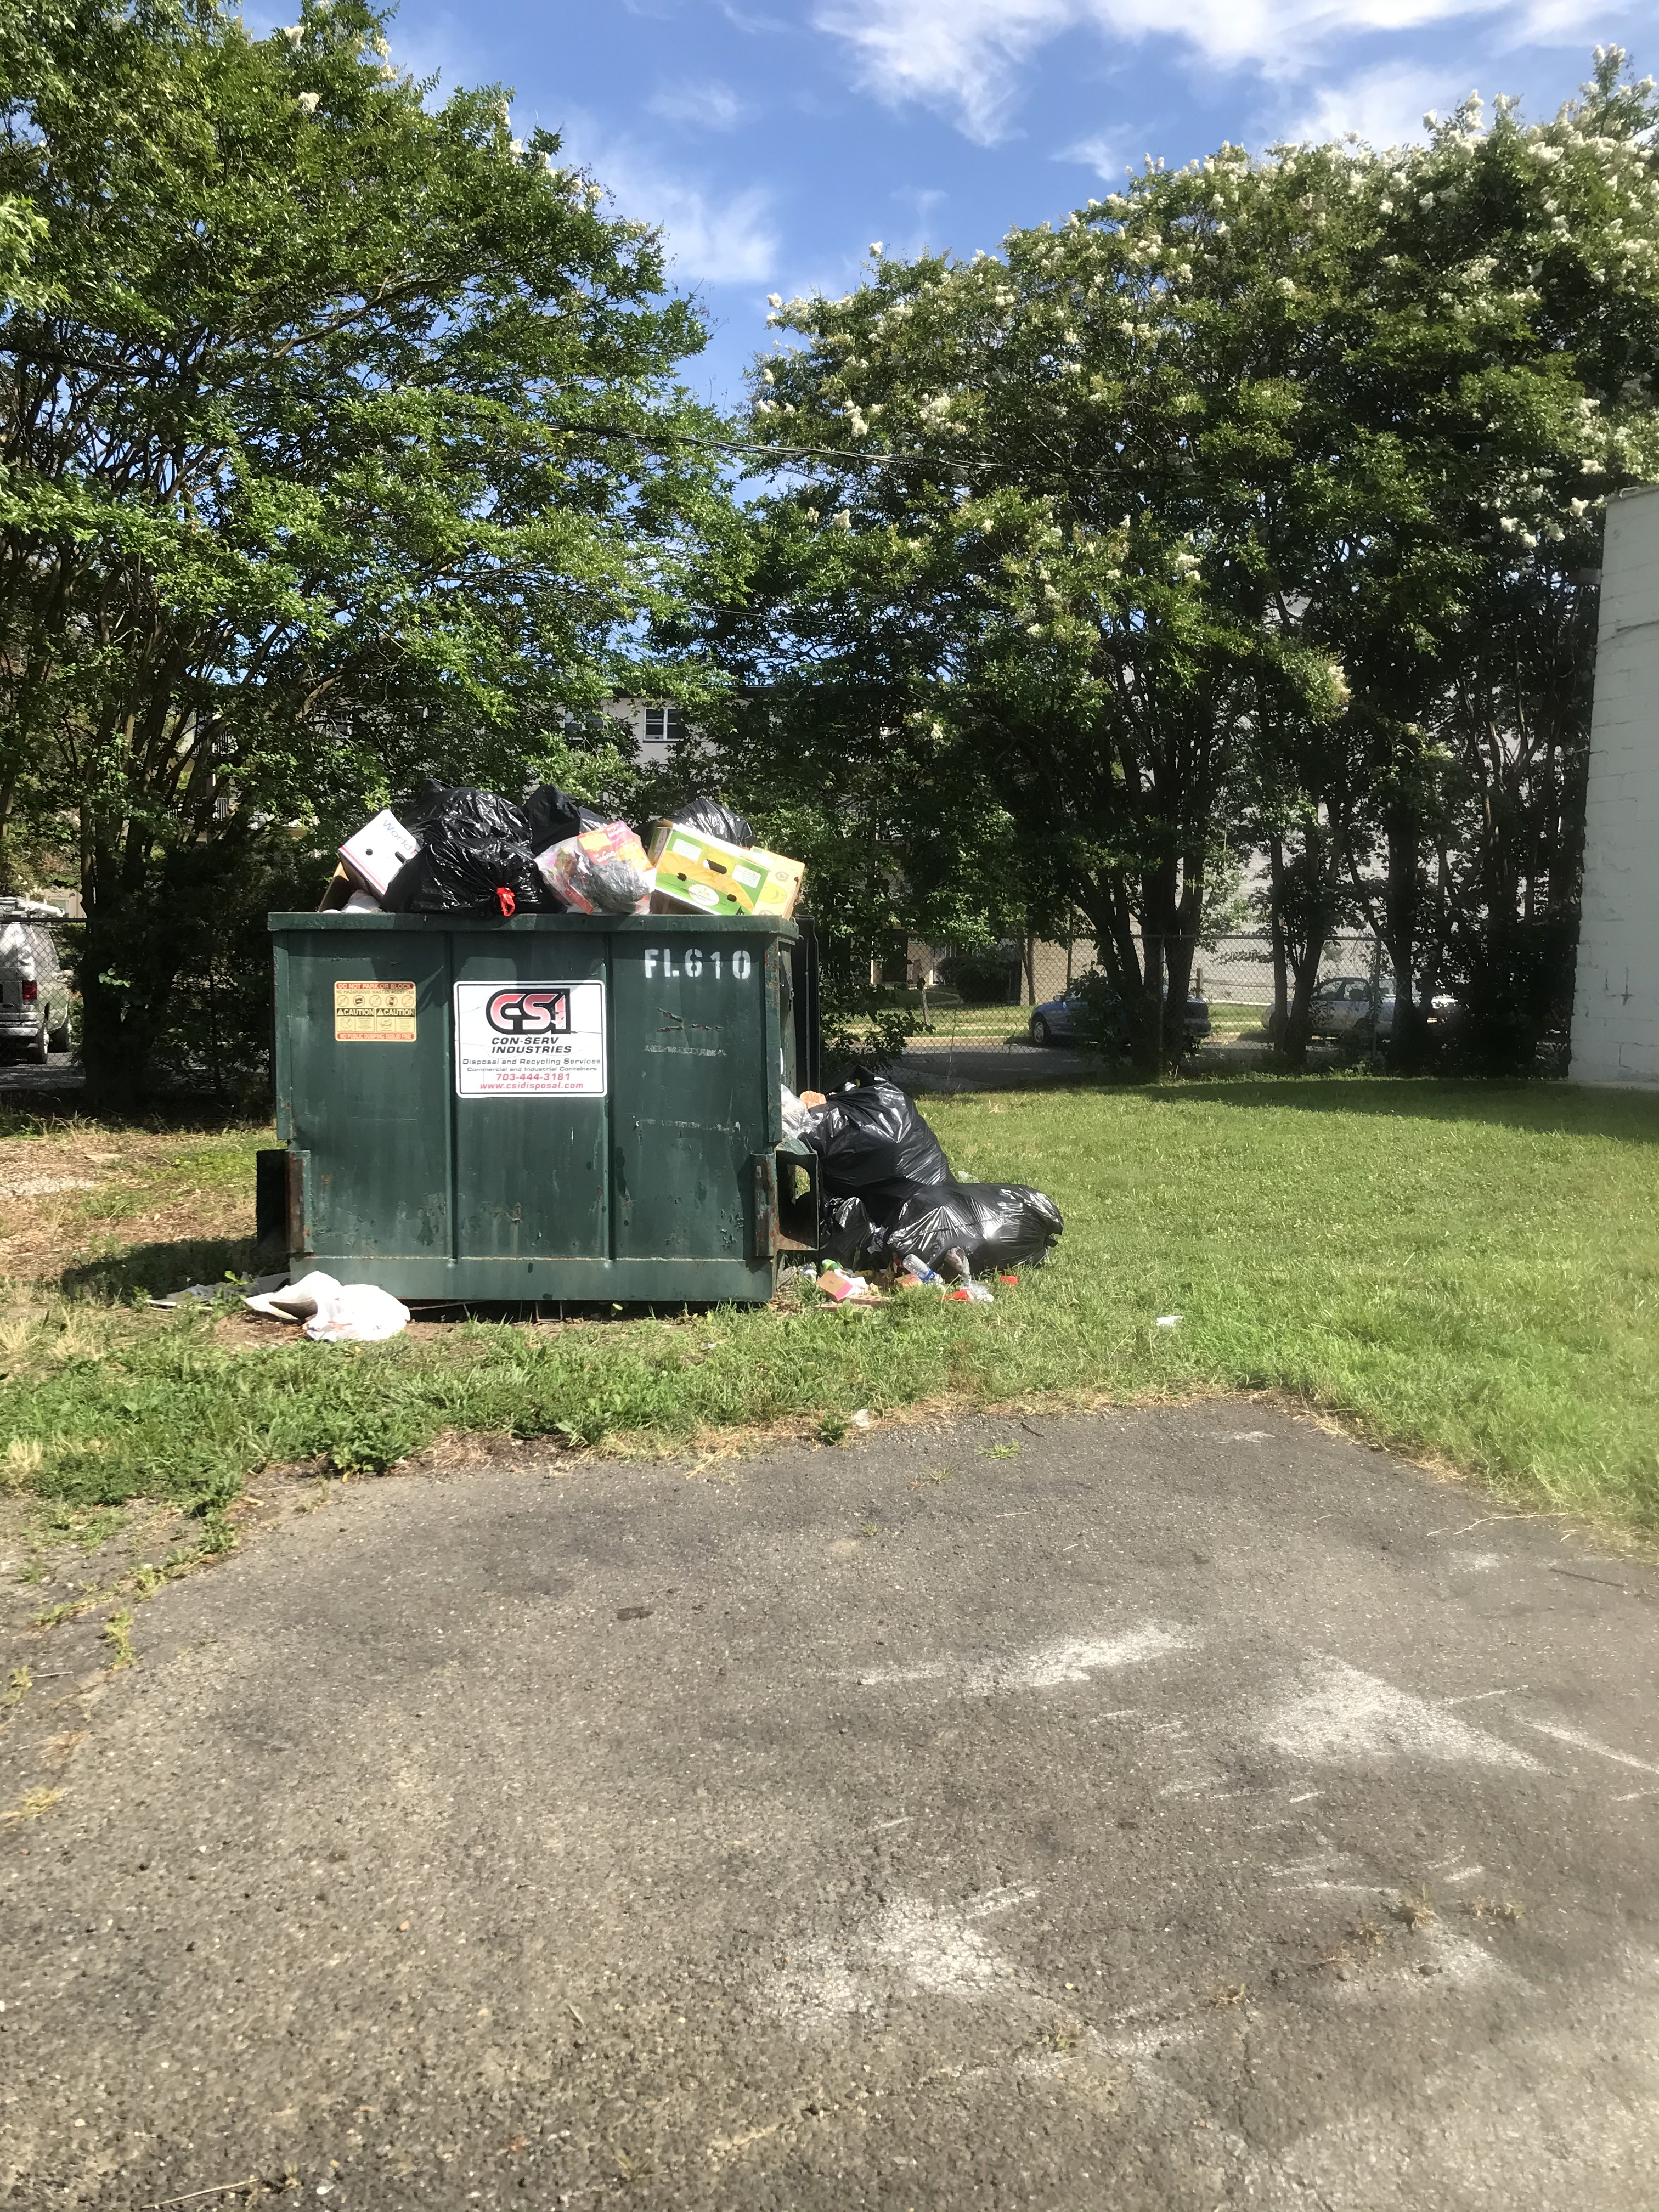
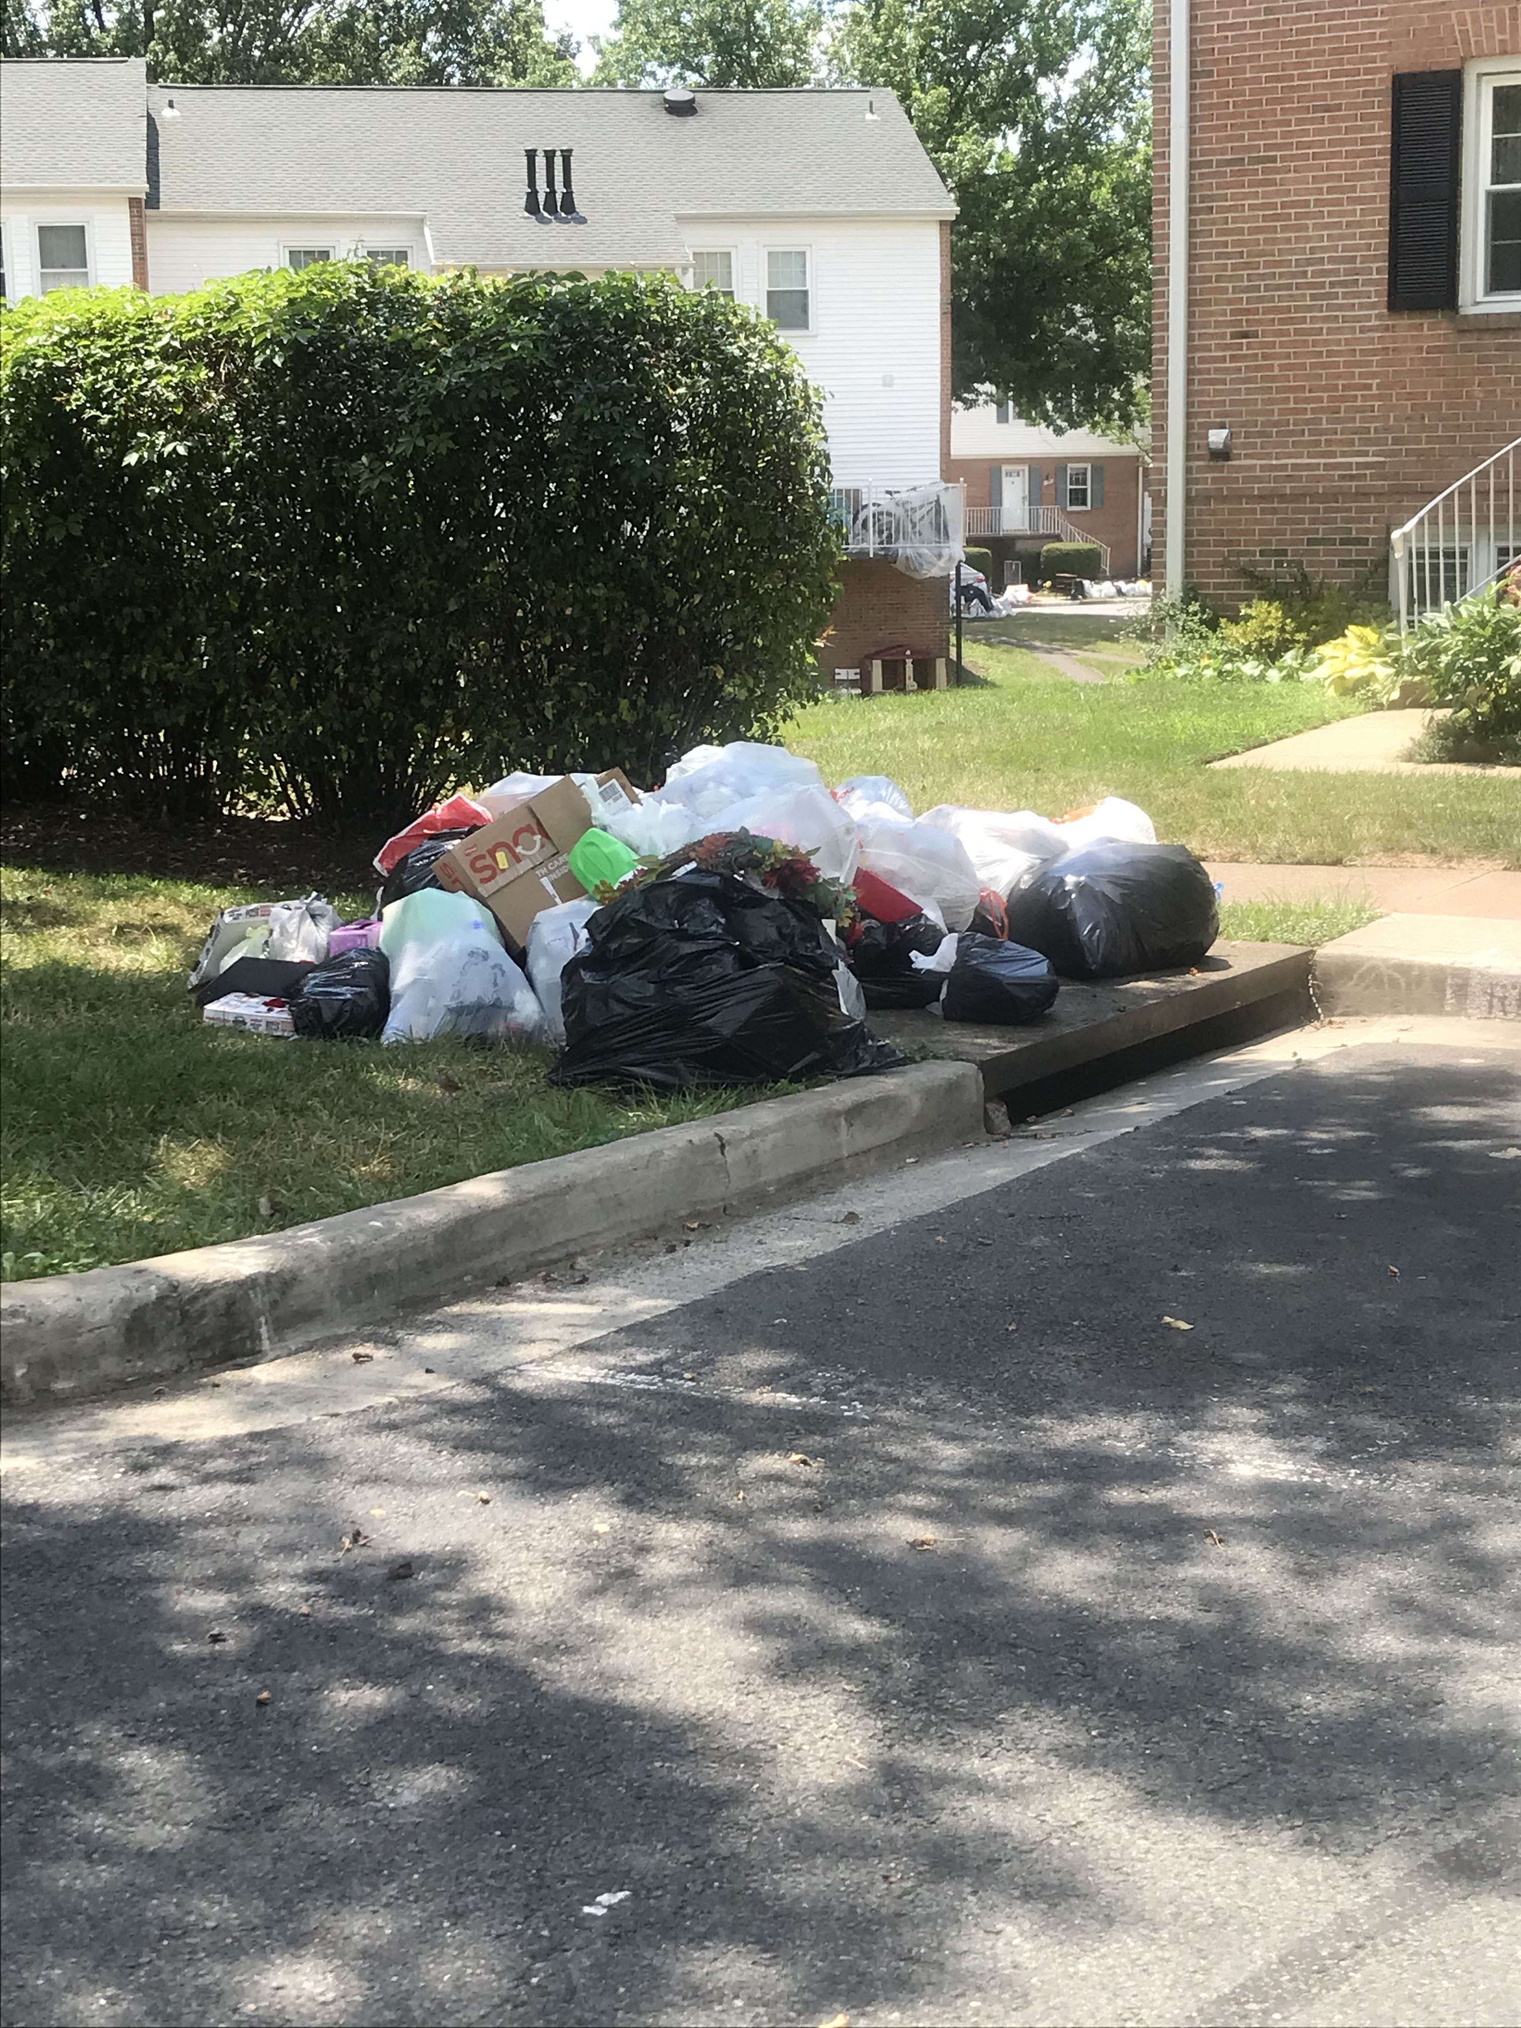
These are some problems in the neighborhoods—Adequacy PLUS lack of containers ON storm drains

Slide 12
Medium-Term Recommendations
Prohibit
Prohibit the use of bags for overnight refuse set-out
Focus on proactive enforcement of adequate waste storage & service standards at medium- and high-density housing
Prohibit
Prohibit waste container placement on (or near) storm drains
Establish
Establish a dedicated litter & illegal dumping enforcement unit
Update
Update methodology used to calculate capacity & servicing need for new & existing development
Focus

Slide 13
Long-Term Ideas To Consider
Recommended Next Steps:
Direct BOCS staff to determine Board Matters/Actions on “low hanging fruit” items
Direct staff from Stakeholder agencies to provide proposals for implementation of selected recommendations
Support
Support Break Free From Plastic Pollution Act
Support
Support Statewide Bottle Bill
Establish
Establish Circular Economy and Extended Producer Responsibility for county contracts, and support source reduction efforts wherever possible
Establish
Establish Prince William County-style “Pre-paid” Disposal

Slide 14
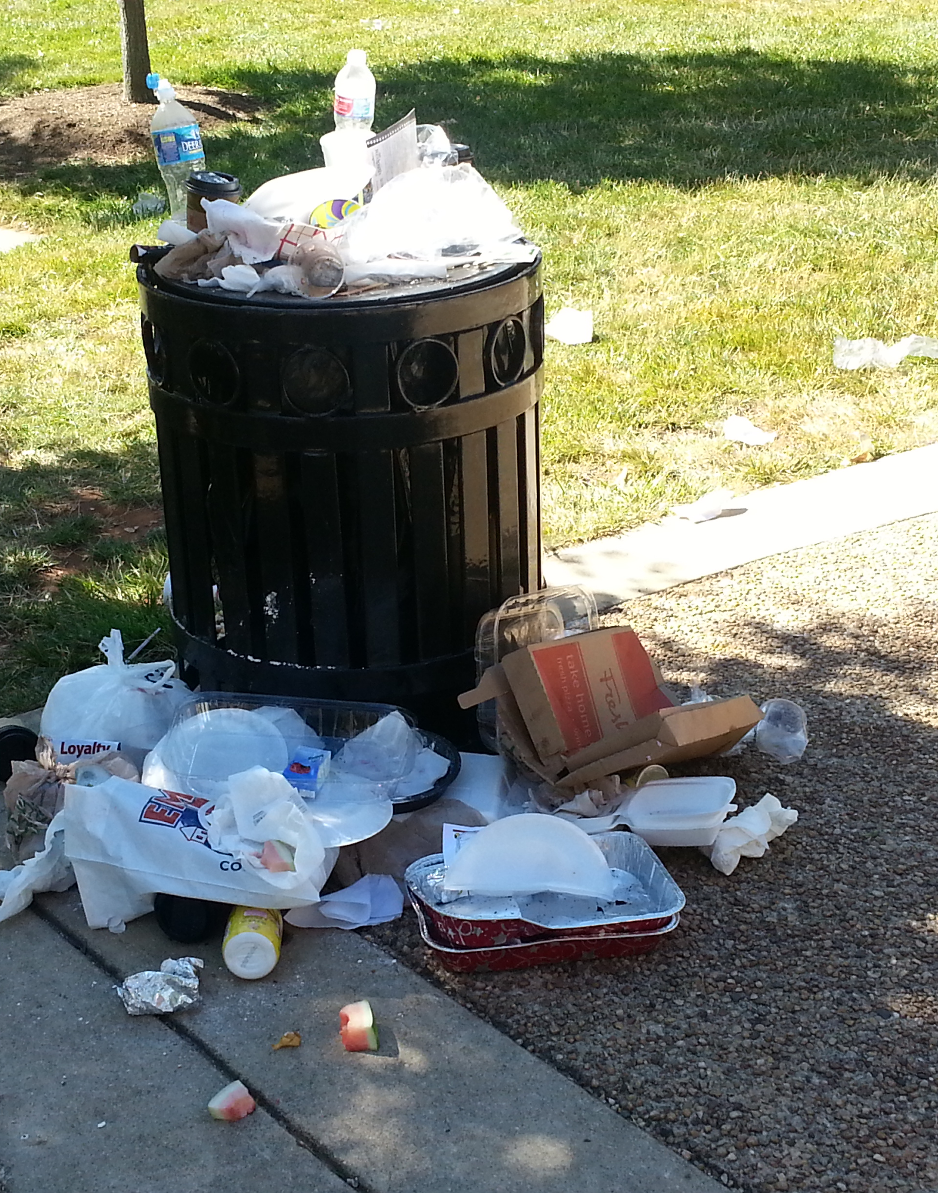
If you’re not part of the solution, you’re part of the pollution
www.cleanfairfax.org
www.LitterFreeVA.org

